Slide 1


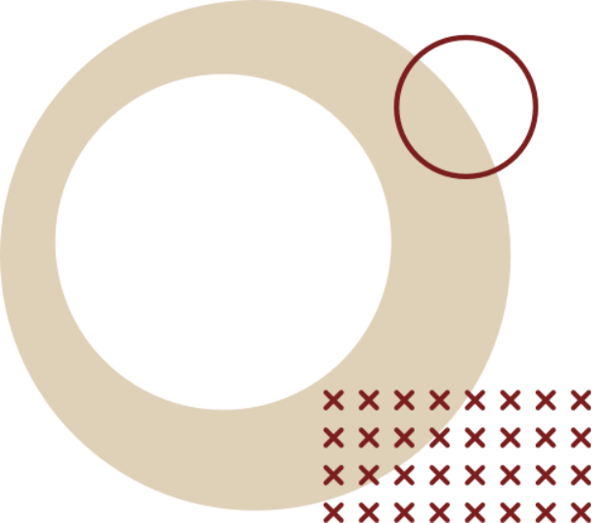

24CDT11 HUMAN COMPUTER INTERACTION
TEAM NAME-SIGMAONE
PRANAVKIRUTHIK M -25CDR064
PRANESH C - 25CDR065
PRITHVERAJAN R B - 25CDR071
RISWAN M - 25CDR077

Slide 2
Sigmaone ~ The Future of Student Computation
The Problem:
Traditional calculators are limited, unintuitive, and don't integrate with modern study habits (e.g., juggling a calculator, phone for notes, and watch for time).
Our Solution:
Introduce the Geo-Calc, a sleek, dual-screen, foldable device designed for the modern student's workflow.

Slide 3
Core Features & Aesthetics
The Form Factor:
  3D Foldable Design: Durable, compact, and protects the screens when closed.
  Premium Build: Metallic Silver Surface with striking Holographic Highlights. Discuss the aesthetic appeal—it's a high-tech status symbol.
  Dual-Screen Innovation:
  Screen 1 (Left): Dedicated Calculator Interface (numbers, symbols, functions). Provides a large, tactile-feeling digital keypad.
  Screen 2 (Right): Information & Notes Hub. Displays Time, Date, and a Quick Math Notes area for formulas or scratch work (highlight the stylus integration).

Slide 4
Student Productivity & Workflow
Integrated Smart Keys:
  Home Button: Instant access to the main dashboard/apps.
  Formula Sheet View: Dedicated key to pull up saved, complex equations instantly (eliminates flipping through notes).
  Data Save: Quick function to save calculation sequences or entered data for later recall.
  Stylus & Input: Discuss the integrated stylus (kept securely beside the charging port) for natural handwriting on the Notes screen.
  Power & Portability: Highlight the small side charging port (USB-C) and the long battery life necessary for a full day of classes.

Slide 5
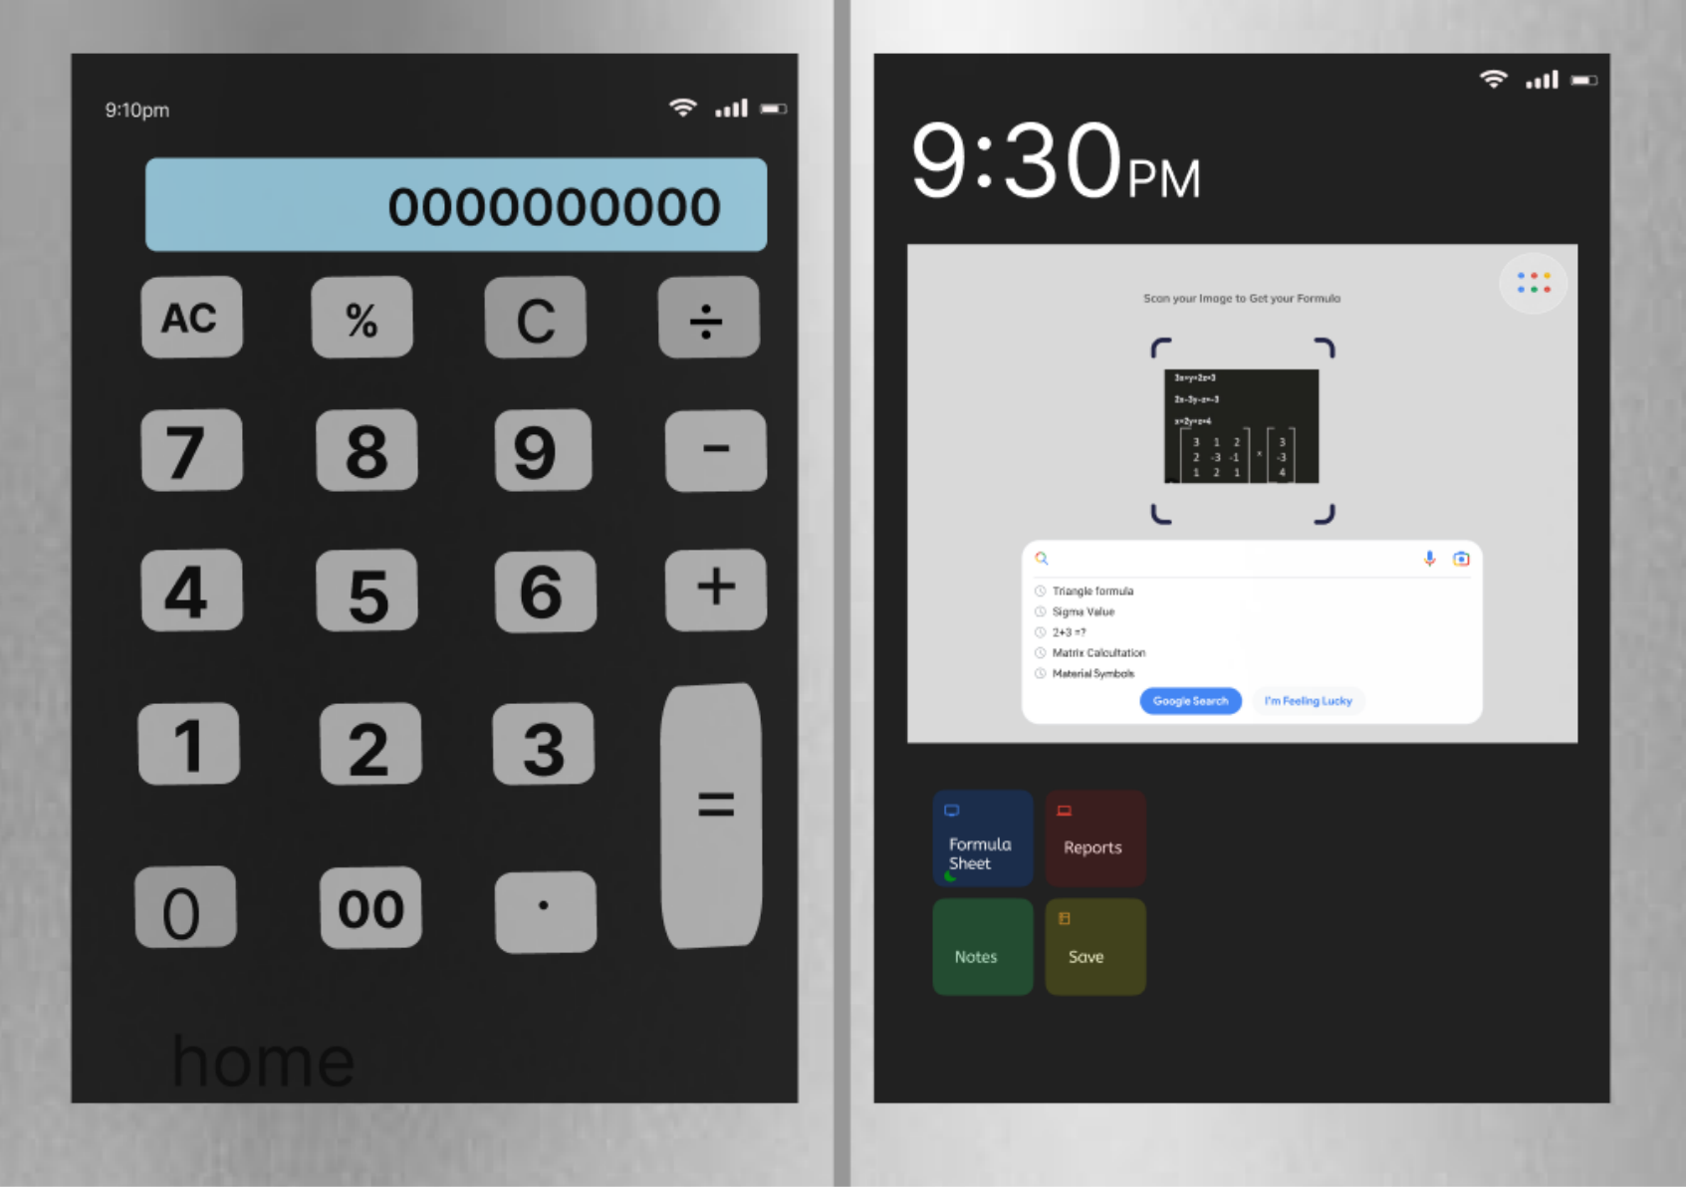

Slide 6
